Slide 1





Data Sets
2 Data formats from same open source database
A_gen.txt
A_nuc.text
A is the HLA gene name. Files should all have the same format. We are looking at:
HLA-A
HLA-B
HLA-C
HLA-DQA1
HLA-DQA2
HLA-DQB1
HLA-DQB2
HLA-DRA
HLA-DRB

Slide 2
Data Set in Depth
what the file contains

Slide 3


Sequences for the allele (bases)
Allele’s
Named Using HLA nomenclature

Slide 4
Symbol | Meaning | Application to Cleaning/code
* | unknown value or sequence is unknown at any point in the alignment | Ignore allele's that contain *
- | Value is repeat of first the character in the same location in the first row. In other words identity to the reference sequence (the first row) is present the base will be displayed as a hyphen | Consider value same as first row | Ex A*01:01:01:01 in group 1, allel1: CAGGAGCAGA A*02:20:02 in group 1 allel1: ---A------ is really CAGAAGCAGA These are both same column, different rows. The '-' means carry the values down.
. | Gap or insertion or deletion has occurred this will be represented by a period | Keep as is, no action required
| | Exon intron boundary | Keep | as is
Screen Clipping of original Data Set. Spaces between columns exist for making the file easier to read

Slide 5
Structure of dataset and the way to read it
Allele
Allele
3,321 allele genes in HLA-A
3,321 rows x Z columns
Allele
Allele
3,321 allele genes in HLA-A
3,321 rows x sum of all columns
Read as one big long file.

Slide 6
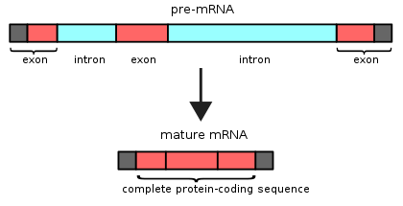
A_gen.txt file for fewer allele’s/rows
(3,321 rows)
Containing exon and intron information but for fewer alleles (rows)
A_nuc.txt file for many allele’s (rows)
>6,000 rows
Contains just exon information allele’s including the exons in the A_gen.txt

